Slide 1
Machine Learning Workshop Session 2

Slide 2
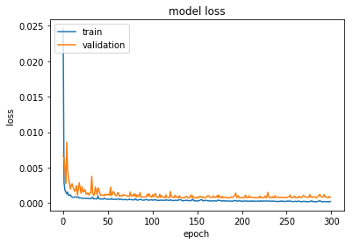
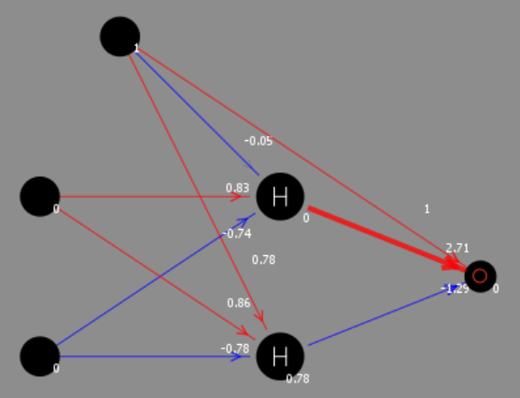
Today’s Aims
Develop some intuition on how neural networks work
Learn how to build, train, improve and use a neural network in Keras

Slide 3
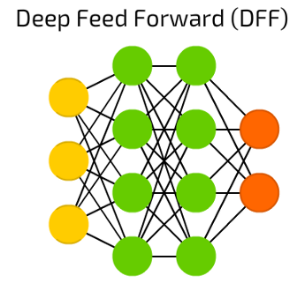
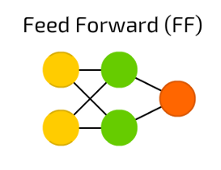
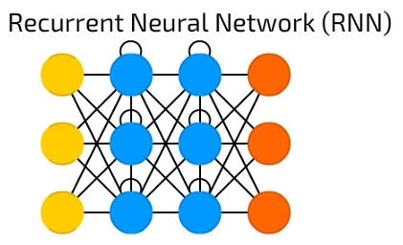
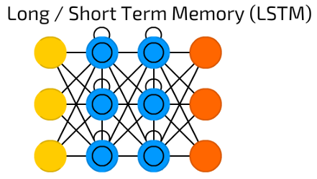
Artificial Neural Network Types
Feedforward Neural Networks (e.g. Multi Layer Perceptron, Convolutional Neural Network)
Recurrent Neural Networks (e.g. Long Short Term Memory)
Image source: https://towardsdatascience.com/the-mostly-complete-chart-of-neural-networks-explained-3fb6f2367464

Slide 4
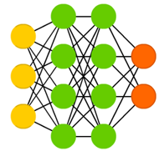
Multi Layer Perceptron (MLP)
Generally very flexible and applicable for many regression and classification tasks
with many different input data types (e.g. text, images, time series)
According to academic literature successfully applied on:
Vehicle spring lifetime prediction
Coal price prediction
Classification of heart dysfunctions
Plant leaf classification
Prediction of credit delinquency
Image source and further reading: https://towardsdatascience.com/the-mostly-complete-chart-of-neural-networks-explained-3fb6f2367464

Slide 5
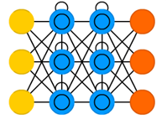
Long Short Term Memory (LSTM)
Advantage over MLP for sequence or temporally dependent data
Heavily used for generative models (e.g. text, speech)
Classification and regression
According to academic literature successfully applied on:
Financial time series prediction
Electricity Demand Forecasting
Traffic Flow Prediction
River discharge Forecasting
Image source and further reading: https://towardsdatascience.com/the-mostly-complete-chart-of-neural-networks-explained-3fb6f2367464

Slide 6
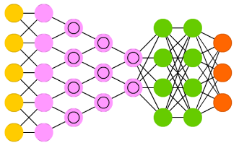
Convolutional Neural Network
Generally work well with data with a spatial relationships (e.g. image data)
Suitable for classification and regression
Typically used for picture, text, speech data
According to academic literature successfully applied on:
Fault detection of high voltage lines
Marine organism detection
Road detection
Food image classification
Stock Market prediction
Image source and further reading: https://towardsdatascience.com/the-mostly-complete-chart-of-neural-networks-explained-3fb6f2367464

Slide 7
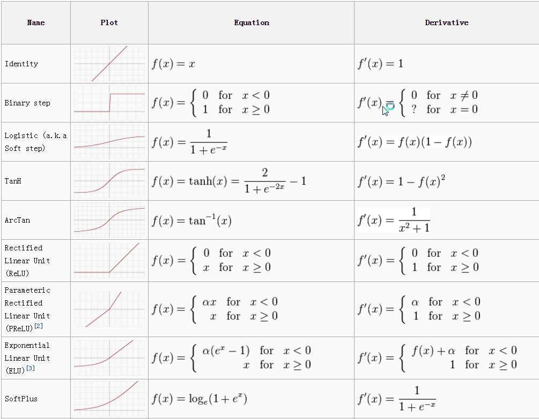
Common activation functions
Logistic and other sigmoid functions
Rectified Linear Unit (ReLU)
SoftPlus
Linear
Further reading: https://medium.com/the-theory-of-everything/understanding-activation-functions-in-neural-networks-9491262884e0
https://missinglink.ai/guides/neural-network-concepts/7-types-neural-network-activation-functions-right/

Slide 8
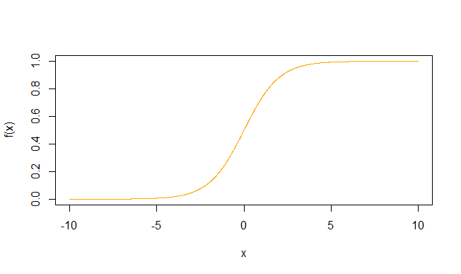
Logistic-Pros and Cons
+
Widely applicable
Function differentiable for whole range of x values
-
Vanishing gradient problem
Lower and upper limits
Gradient low outside range
Sensitive to scaling → see Exercise
Slower convergence compared with ReLU

Slide 9
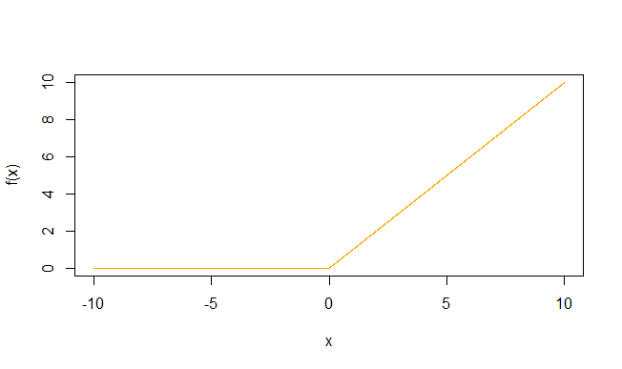
ReLU-Pros and Cons
+
Simple forward + backpropagation → fast convergence
Vanishing gradient problem reduced
-
Derivative for negative x = 0
Dying ReLU problem
Not differentiable when x = 0

Slide 10
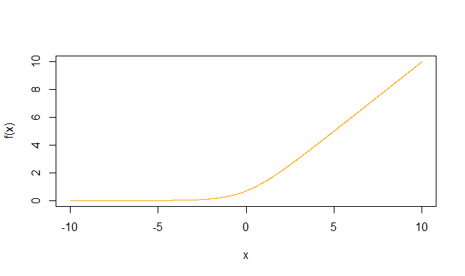
Softplus-Pros and Cons
+
Differentiable for whole x range
No upper limit
No dying neuron problem
-
Can cause overflow for high values of x due to e^{x} in the equation
Slower convergence than ReLU

Slide 11
Develop Intuition - Exercise
Using an agent-based Neural Network Model we will:
Experiment with different activation functions and learning rates and see how this affects the amount of iterations needed for convergence
Examine how input weights influence the shape of the representative activation functions
Examine how a representation of the output function may look like depending on previous weights and activations
https://bit.ly/2LtCgVR
(we also encourage you to play around with the exercises on the following website: http://neuralnetworksanddeeplearning.com/chap4.html)

Slide 12
How to build, train, use and improve an artificial neural network in Keras

Slide 13
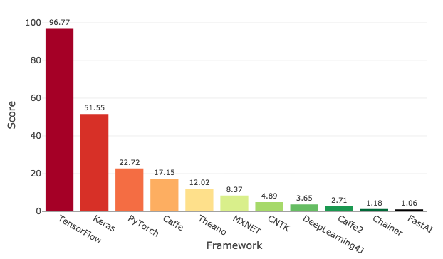
Why Keras? Why Tensorflow?
Keras is a high-level neural networks API for Python with following selectable backends:
TensorFlow: Open Source Machine Learning Framework originally developed by Google
Microsoft Cognitive Toolkit (CNTK): open source deep-learning toolkit from Microsoft
Theano: Python library to efficiently define, optimize, and evaluate mathematical expressions; no ready to use machine learning framework
TensorFlow recommended by Keras
Seamless GPU computing
A lot of examples and already pre trained models available
Image source: https://towardsdatascience.com/deep-learning-framework-power-scores-2018-23607ddf297a
Notes:
Job listings, google search volume, usage surveys

Slide 14
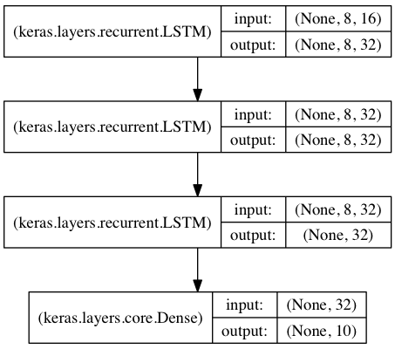
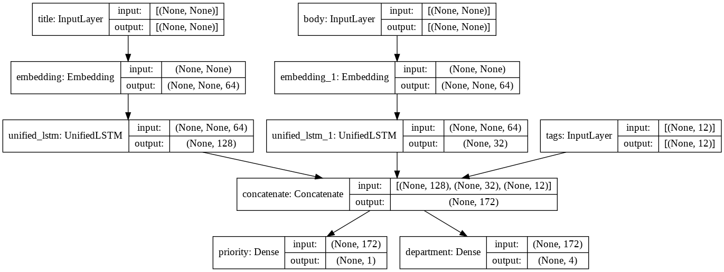
Keras Sequential vs Functional API
Sequential API
Easier to setup
Less flexible
Functional API
More complex, flexible models possible
Shared layers, custom layers, weights between models
Multiple inputs (e.g. layers, models)
Which building blocks do we need for a sequential model?
Image sources: https://keras.io/

Slide 15
Building blocks of a Keras Neural Network-Layers
Many different types of layers: Dense, Convolutional, Recurrent layers,
Dropout layers
Possibility to implement user-defined layers
Basic function to add a layer:
model.add(Dense(units = 32))
Image source and further reading: https://keras.io/

Slide 16
Building blocks of a Keras Neural Network-Optimizers
Constant learning rate may lead to slow convergence or divergence
Optimizers
Stochastic gradient descent (SGD)
RMSprop
Adam
Adagrad
Image source and further reading: https://www.dlology.com/blog/quick-notes-on-how-to-choose-optimizer-in-keras/

Slide 17
Building blocks of a Keras Neural Network-Loss
Function the model is trained on
14 pre-defined loss functions
User-defined loss functions allowed
Regression:
Mean squared error
Mean absolute error
Classification:
Categorical cross-entropy
Basic function:
model.compile(loss='mean_squared_error', optimizer='sgd')
Further reading: https://keras.io/

Slide 18
Building blocks of a Keras Neural Network- Metrics
Similar to loss function, except results are not used in the training process
Allows output of several metrics
Custom metrics allowed
Not required for model compilation
Basic function:
model.compile(loss='mean_squared_error', optimizer='sgd', metrics=['mae', 'acc'])
Further reading: https://keras.io/

Slide 19
Keras Runtime Example - CPU vs. GPU
CPU
2 x Intel Xeon E5 2690 V1
18 physical cores
1447 Input Features
4 x 60 Hidden Nodes
100 Epochs
Runtime: 120.6 seconds
GPU
NVIDIA GTX 750 TI
1447 Input Features
4 x 60 Hidden Nodes
100 Epochs
Runtime: 80.9 seconds

Slide 20
Steps towards better model performance
Data
Network Architecture Tuning
Play around with:
Weight Initialization
Learning Rates
Activation Functions
Network Topology
Batches and Epochs
Optimizers and Losses
Or use
Find more data
Generate more data
Resampling/Model Ensembles
Automated hyperparameter optimization
Use Hyperas + Hyperopt
Develop your own optimization function

Slide 21
Practical Example - Wind Power Electricity Generation Prediction
Installation Troubleshooting
Basic Model
Improve performance by Scaling Input Data
Generate Additional Data (Add Noise, Derive Wind Direction Variable, be creative)
Experiment with Network Architecture (Depth, Width, Dropout)
Experiment with Activation Functions, Optimizers and Batch Sizes
(Bonus: Compare run times between CPU and GPU)

Slide 22
Additional Issues
Any further questions?

